Slide 1
Automated Application-Optimal Battery System Design
Levels of Freedom in Layouting Battery System Configurations
Cell block
Y
Cell
Number of cells in a row: C_{R}
X
Number of rows: C_{N}

Slide 2
Automated Application-Optimal Battery System Design
Levels of Freedom in Layouting Battery System Configurations
Module
Y
Cell Block
Number of Cell Blocks in a
row: M_{R}
X
Number of rows: M_{N}

Slide 3
Automated Application-Optimal Battery System Design
Levels of Freedom in Layouting Battery System Configurations
String
Y
Module
Z
Number of Modules in a
row: S_{R}
X
Number of rows: S_{N}

Slide 4
Automated Application-Optimal Battery System Design
Levels of Freedom in Layouting Battery System Configurations
Pack
Y
String
Z
Number of Strings in a
row: P_{R}
Number of
Layers: P_{L}
X
Number of rows: P_{N}

Slide 5
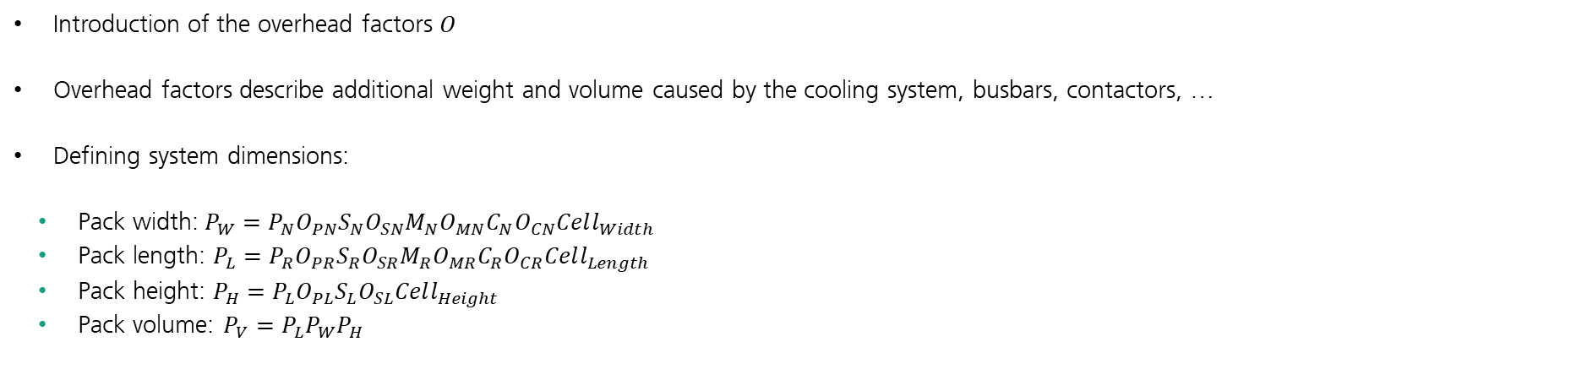
Automated Application-Optimal Battery System Design
Integration: Introduction of Inevitable Overhead
Introduction of the overhead factors 𝑂
Overhead factors describe additional weight and volume caused by the cooling system, busbars, contactors, …
Defining system dimensions:
Pack width:$P_{W}=P_{N}O_{PN}S_{N}O_{SN}M_{N}O_{MN}C_{N}O_{CN}Cell_{Width}$
Pack length: $P_{L}=P_{R}O_{PR}S_{R}O_{SR}M_{R}O_{MR}C_{R}O_{CR}Cell_{Length}$
Pack height: $P_{H}=P_{L}O_{PL}S_{L}O_{SL}Cell_{Height}$
Pack volume: $P_{V}=P_{L}P_{W}P_{H}$

Slide 6
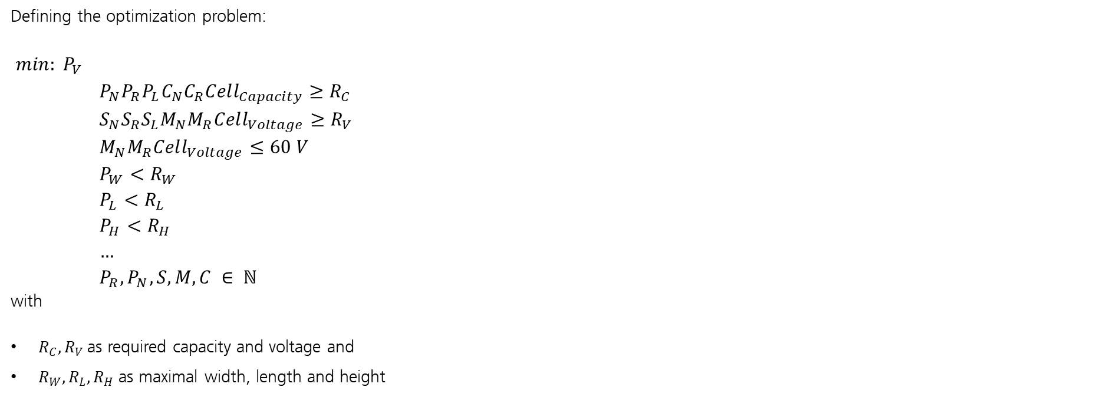
Automated Application-Optimal Battery System Design
Defining the Optimization Problem
Defining the optimization problem:
$min: P_{V}$ ${P_{N}P_{R}P_{L}C_{N}C_{R}Cell_{Capacity}≥R}_{C}$ $S_{N}S_{R}S_{L}M_{N}M_{R}Cell_{Voltage}≥R_{V}$ $M_{N}M_{R}Cell_{Voltage}≤60 V$ $P_{W}<R_{W}$ $P_{L}<R_{L}$ $P_{H}<R_{H}$ $…$ $P_{R},P_{N},S,M,C ∈ ℕ$ with
$R_{C}, R_{V}$as required capacity and voltage and
$R_{W}, R_{L}, R_{H}$ as maximal width, length and height

Slide 7
Automated Application-Optimal Battery System Design
Possible ways to solve the Optimization Problem
An optimization algorithm generating more than one valid solution is needed
Evolutional algorithm could also solve these kind of integer optimization programs, but with a lot of overhead for smaller battery systems
The computation cost of the backtracking algorithm increases with O(z5), where z is the maximum search depth (max parameter value)
Defining maximum values for the parameters at the beginning would reduce the computation cost
The parameter sets related to the parallel or the series connection can be considered as separate optimization program

Slide 8
Automated Application-Optimal Battery System Design
Modified Backtracking
Solving optimization problem with a modified backtracking algorithm:
Example for capacity
Root
…
P_{L} 1 2 3 …
C_{N} 1 2 3 …
P_{N} 1 2 3 …
C_{R} 1 2 3 … 44 Req. Capacity reached
P_{R} 1 2 3 …
Each time the requirements are fulfilled, the actual
parameter set is saved, and a new parameter set is
searched in next branch.
The backtracking algorithm is only applied to obtain
all parameter sets that fulfill the voltage and capacity
requirements.
C_{N} 1 2 3 …
C_{R} 1 2 3 …

Slide 9
Automated Application-Optimal Battery System Design
Permutation
The number of iterations required to find all combinations of parameters that satisfy the requirement (capacitance or voltage) and act as lower bounds can be reduced by using permutations
Example for the capacity:
Tuple (10,1,1,1,1) fulfills the capacity requirements then (1,10,1,1,1),(1,1,10,1,1),(1,1,1,10,1) and (1,1,1,1,10) also fulfills the requirements
The permutation induces a symmetry in the parameter space
Hence all solution for optimization problem can be found by determining the solution on one side of one of the symmetric axis and use the permutation on them
Moreover, the highest parameter minus one in the lower branch is the upper bound of the parameter of the next branch
(10,1,1,1,1)
(1,10,1,1,1)
(1,1,10,1,1)
(1,1,1,10,1)
(1,10,1,1,10)
(5,2,1,1,1)
(2,5,1,1,1)
(2,1,5,1,1)
(2,1,1,5,1)
(2,1,1,5,5)
(…)
(4,3,1,1,1)
(3,4,1,1,1)
(3,1,4,1,1)
(3,1,1,4,1)
(3,1,1,1,4)
(…)
(3,2,2,1,1)
(2,3,2,1,1)
(2,2,3,1,1)
(2,2,1,3,1)
(2,2,1,1,3)
(…)
(2,2,2,2,1)
(2,2,2,1,2)
(2,2,1,2,2)
(2,1,2,2,2)
(1,2,2,2,2)

Slide 10
Automated Application-Optimal Battery System Design
Ranking of the solutions
Filter & Sorting
The list of parameter sets found by the backtracking algorithm is reduced by applying filters to the list. The filters represent the conditions acting as upper limit
After all parameter sets are filtered and therefore fulfilling all conditions, the list of parameter sets is sorted by the volume

Slide 11
Automated Application-Optimal Battery System Design
Parallel & Series Connection
Parallel connection
The parallel connection of string and cells should be always possible and therefore it should not cause any problems
Series connection
For a series connection of neighboring modules in a string or neighboring cell blocks in a module, a chain with certain start and end points (terminals) is searched for
The existence of such chain depends on the number of modules/cell blocks and their arrangement and cannot be guaranteed

Slide 12
Automated Application-Optimal Battery System Design
Basic Battery Model Interdependencies
I(t_{n+1})
SOC-Model
SOC(t_{n})
T_{BAT}(t_{n})
T-Model
SOH_{C}(t_{n})
SOH_{R}(t_{n})
SOH_{C} -Model
SOH_{R} -Model

Slide 13
Automated Application-Optimal Battery System Design
Levels of Freedom in Layouting Battery System Configurations
Cell block
Y
Cell
Cell block
X

Slide 14
Automated Application-Optimal Battery System Design
Levels of Freedom in Layouting Battery System Configurations
Module
Y
Cell block
Module
X

Slide 15
Automated Application-Optimal Battery System Design
Levels of Freedom in Layouting Battery System Configurations
String
Y
Module
Z
String
X

Slide 16
Automated Application-Optimal Battery System Design
Levels of Freedom in Layouting Battery System Configurations
Pack
Y
String
Z
Pack
X

